Slide 1
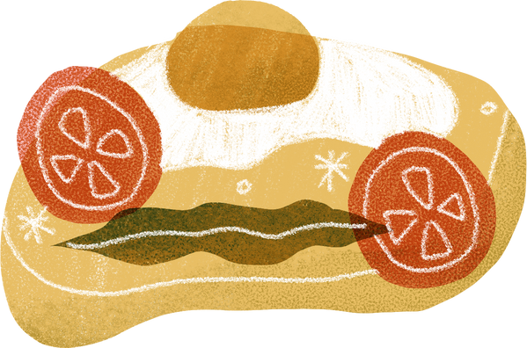
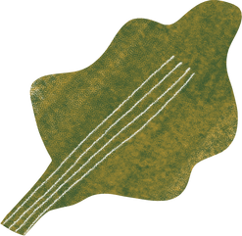
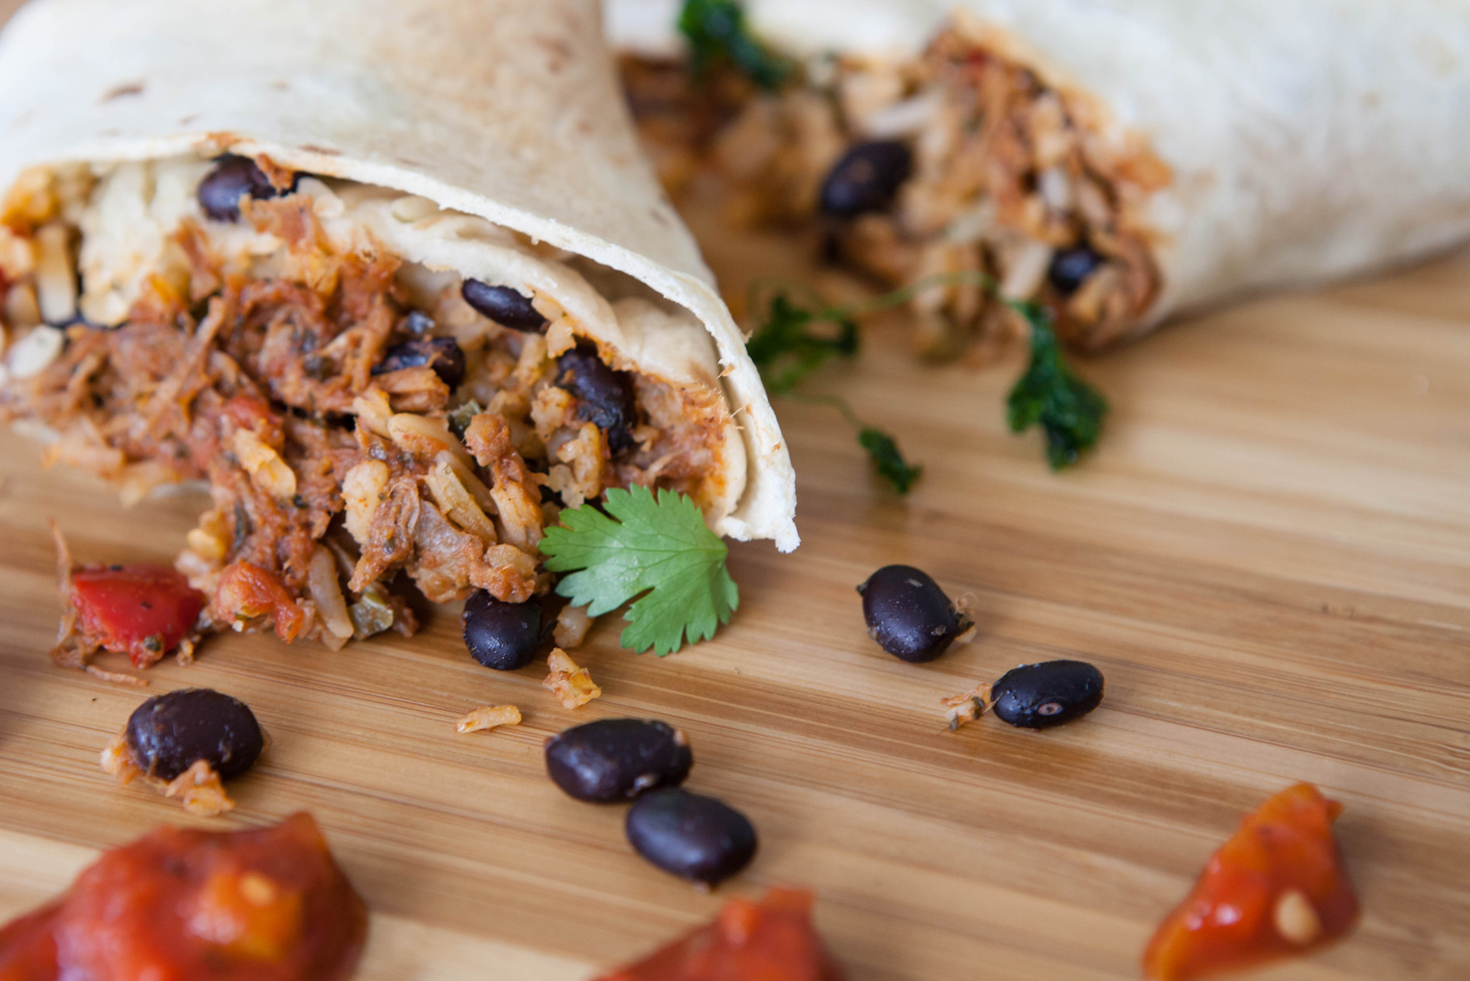
Food Donation Web Application
IM/2018/036
M.D.N.JAYASIRI
Notes:
slide 1 -
I am dilini jayasiri. and this video includes an overview of my design project
slide -2
I am doing a food donation management system.
and today lineup is here
slide -3
let's look at how food donation happens manually. At present, if any donor wants to donate food for needy poor people they can directly go to them and donate food. And also there are some non-government organizations that are maintained and have contact with that kind of people. So then donors can contact them and through them, they can donate food. Not only that donors go and talk with the children's homes and nursing homes to donate food. Those are the main methods to donate food to needy people.
Slide 4
As problem identification, I have identified two main problems. The first one is there are so many people who are suffering from hunger issues. And also sometimes nursing homes and children's homes have to face the same issue because they are also unable to find sponsors for food. The other problem is a lot of foods are wasted in many ways by producing excess foods on many occasions like parties, weddings, etc.
Slide – 5
So that I am supposed to find a solution for these two problems.
Slide – 6
The solution is a food donation web application. The application acts as an interface between the users who are looking for a channel to give the excess food without wasting it. It enables donors to donate the excess food by notifying nearby users with the details of the food that is available. The required users claim the notification. And also NGOs and children's homes can request food by publishing the request through the website. If any donors are willing to fulfill the food requirement they can accept the request.
Those are the solutions that I am supposed to overcome in my proposed project
Slide 7
As you can see my application connect both donors and recipient. Donors can search organizations which are required food through the web side. And also children homes, nursing homes and NGO can

Slide 2



Today Lineup
Introduction
Requirements
Main Functionalities
Not Completed Functionalities
Used Technologies
Demonstration

Slide 3
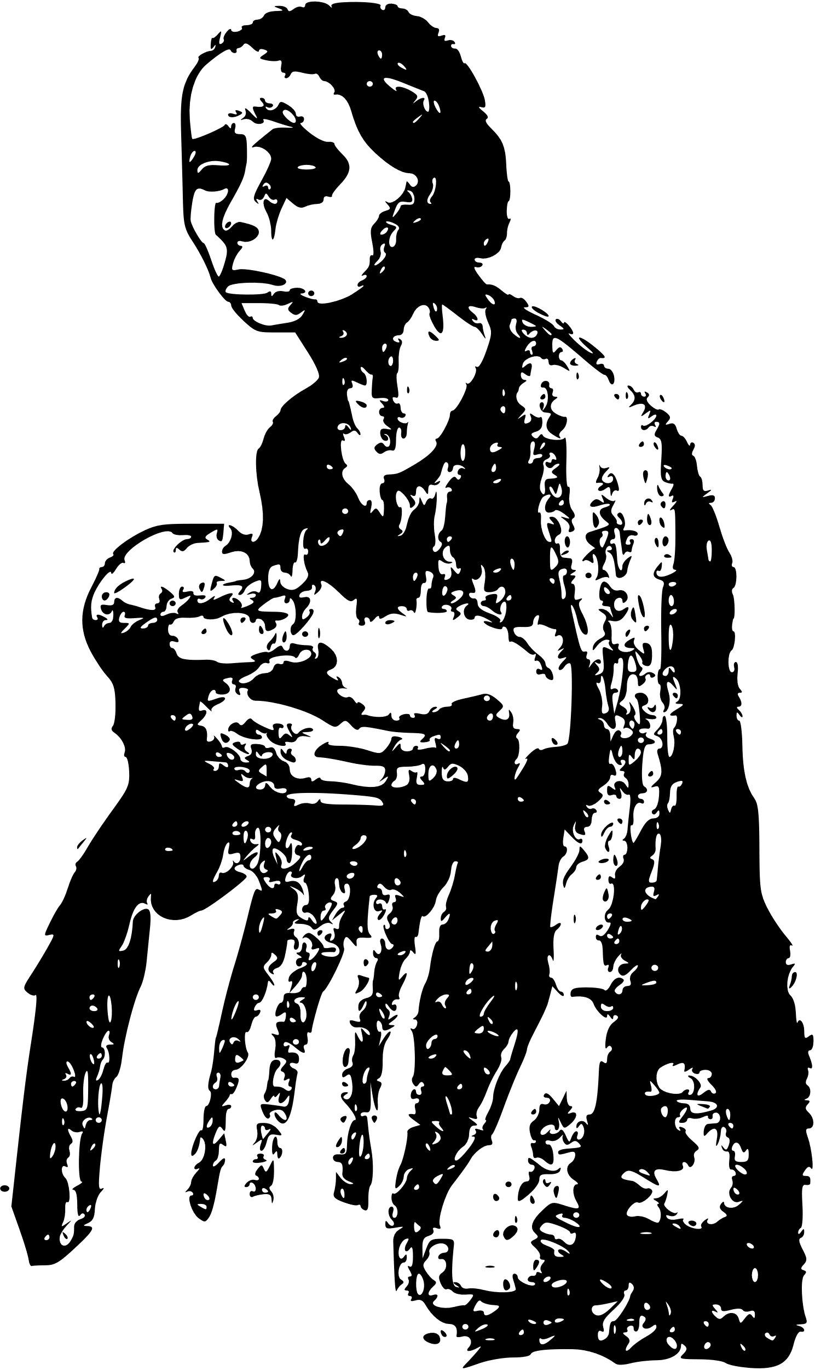
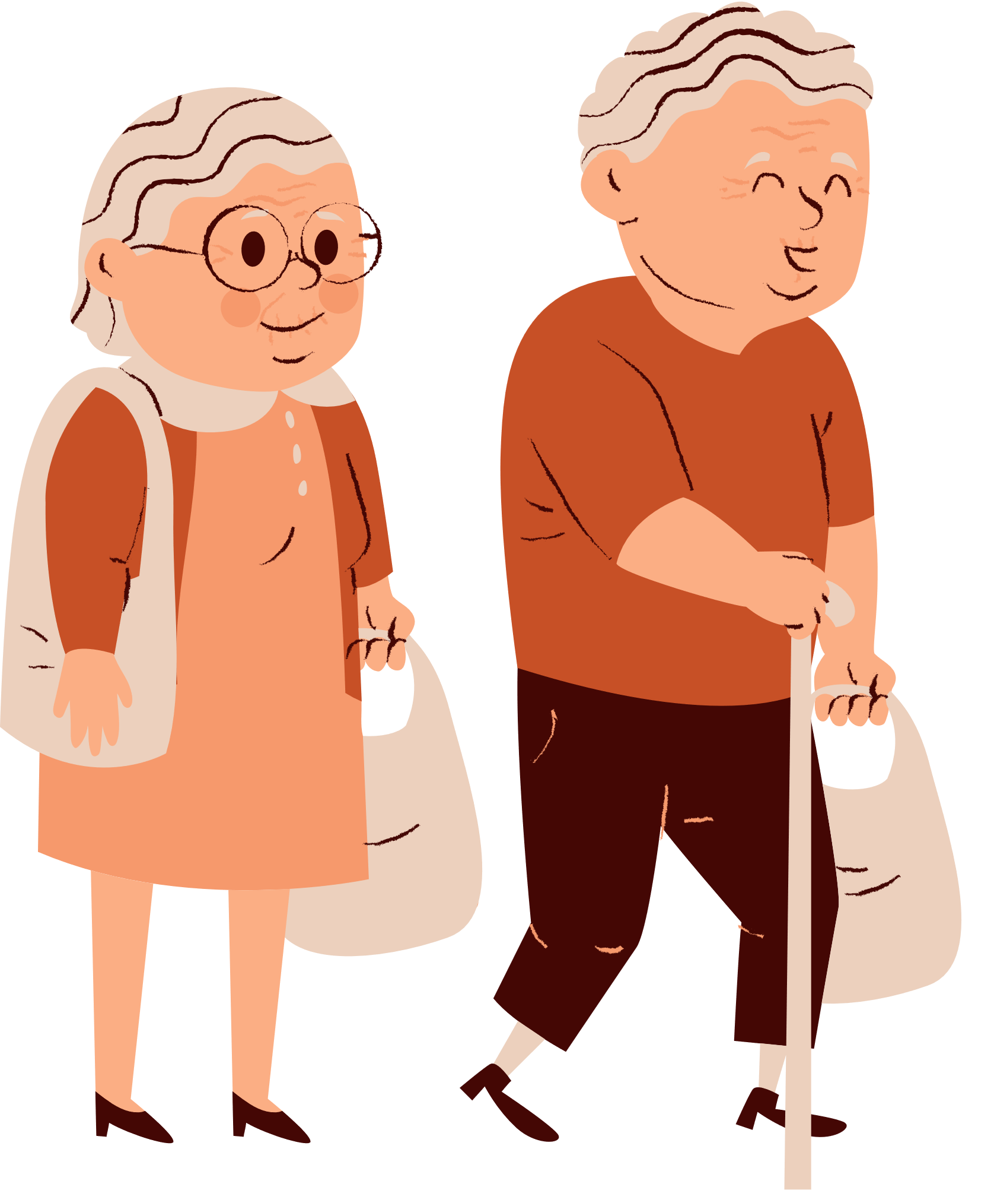
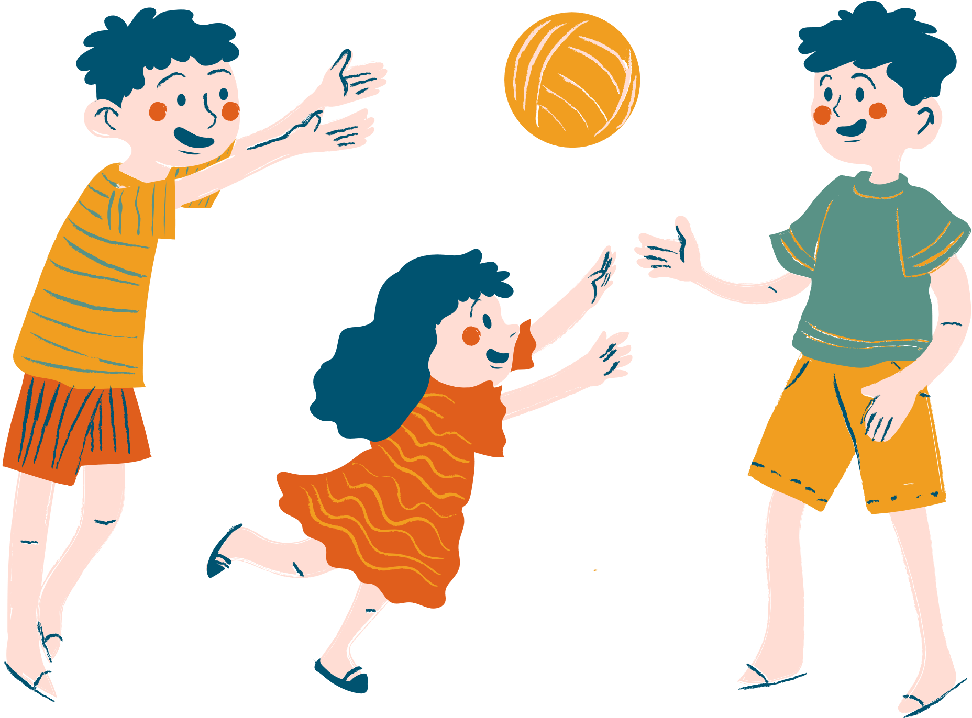

Current Process
Poor people
Children homes and nursing homes
NGO
Individual Donor
Restaurant admin

Slide 4


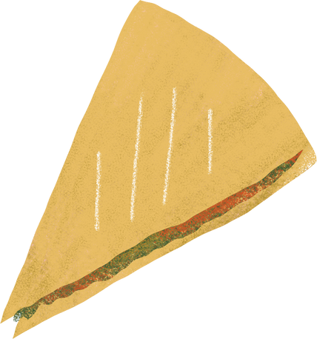
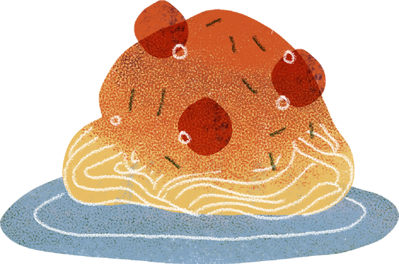


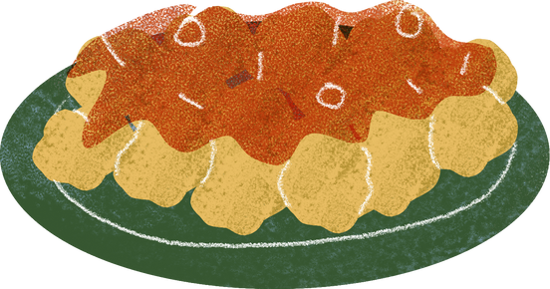
Solution

Slide 5
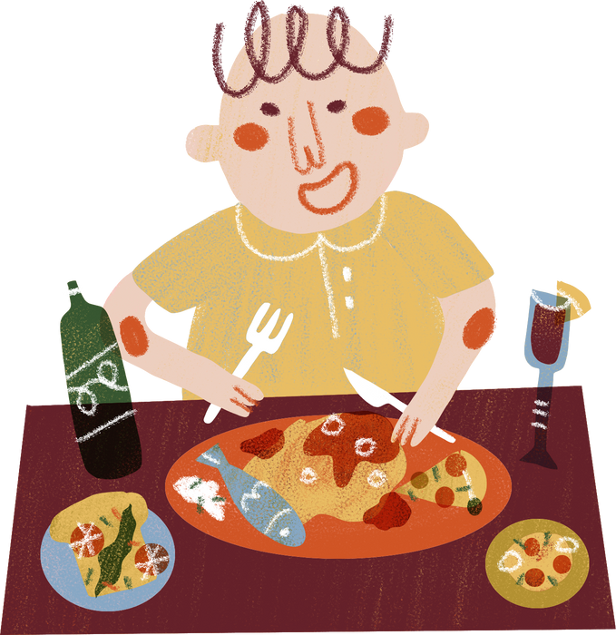
THE WEB APPLICATION FOR FOOD DONATION ACTS AS AN INTERFACE BETWEEN THE USERS WHO ARE LOOKING FOR A CHANNEL TO GIVE THE EXCESS FOOD WITHOUT WASTING IT.

Slide 6



Donors
Needy people
Requesting Food
Requesting Donate food
Donors
Needy people

Slide 7

Main Functionalities
Donor and Needy Organizations can register to the system
Needy Organization can state their food requirements and request food through the website.
View and Update the Calendar.
Donors can make a donation request according to their preference.
Receive the Email sent by donors
Accept Donation.
View the donors and donation details by Admin.

Slide 8
Not Completed Functionalities
1. Ability to set the location of donors or restaurants on Google Maps.
2. Ability to confirm the accuracy of the documents submitted by the NGO to make secure the process
3. Authorized users based on their role.

Slide 9
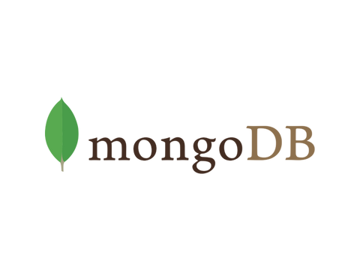

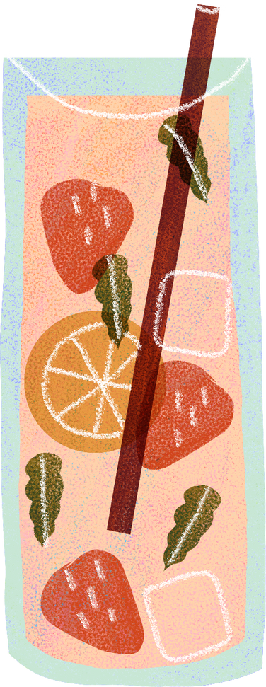


Technologies

Slide 10
Demonstration

